Slide 1





MODULE 1 -Introduction to C.A.P & Introduction to Cyber Space
Sailaja Vadlamudi

Slide 2
CLASS 1 – 45 MINS
Introduction to CAP /Objective Why Need of CAP platform Oath for becoming Council Member What is Cyber Space
Basic Rules Digital Citizenship & Netiquettes Creation of Online Email Group/ WhatsApp Group of Members How to Use Google DOCS, Sheets, Forms, Meet
Extensions and Addons
Digital Assistants – Siri, Hello Google ,Alexa,

Slide 3



ఉపయోగకరమైన సైబర్ స్పేస్
డిజిటల్ టూల్స్ అనేవి మనకి ఉపయోగపడే అద్భుతమైన పరికరాలు –
కొత్త ప్రావీణ్యం గానీ, నైపుణ్యం గానీ నేర్చుకోవడానికి
ఎక్కడో దూరంగా ఉన్న వాళ్ళతో ఆడటానికి గానీ
మనకి నచ్చిన సంగీతాన్ని వింటూ ఆస్వాదించడానికి గానీ
మన భావాలను ఒకరితో పంచుకోవడానికి గానీ
ముద్దుగా ఉండే కుక్కపిల్లల ఫోటోలు పంచుకోవడానికి గానీ
అమ్మమ్మ, నానమ్మ, తాతయ్యాల కు మందులు కొనివ్వడానికి గానీ ఉపయోగపడుతుంది

Slide 4



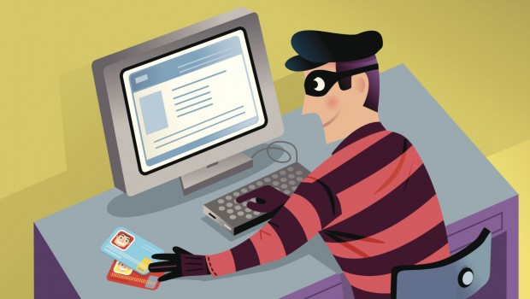
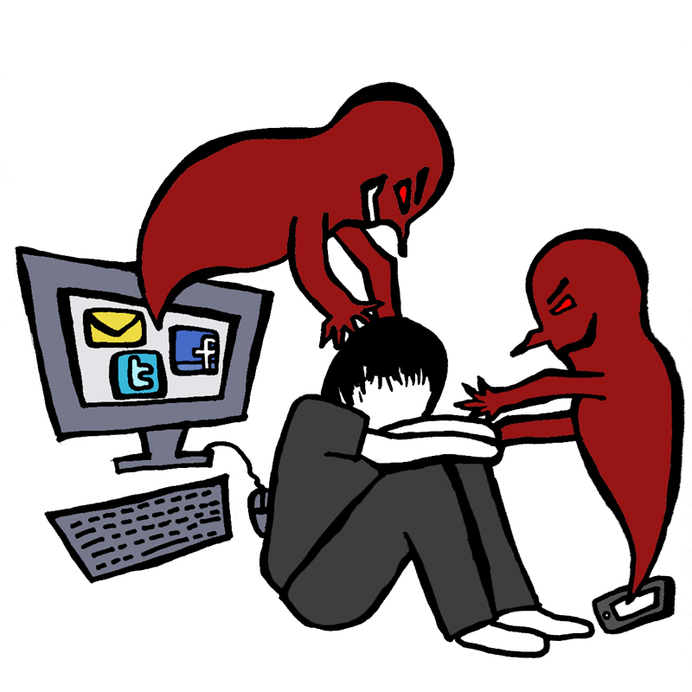
సేఫ్ సైబర్ స్పేస్ ?
“నా ఫోటోలను ఎవరో తప్పుగా వాడుతున్నారు”
ఒక వస్తువుని చెడు కోసం ఉపయోగిస్తారు కొంత మంది!
“ఎవరో నన్ను బెదిరిస్తూ సందేశాలు పంపిస్తున్నారు”
“ఎవరో నా గురించి దుష్ప్రచారం చేస్తున్నారు”

Slide 5
A SAFE CYBERSPACE?
“SOMEONE IS MISUSING MY PHOTOS”
Every good tool can be misused by
cyber criminals!
“SOMEONE IS HURTING MY REPUTATION WITH A FAKE ACCOUNT”
“SOMEONE IS SENDING ME SCARY
MESSAGES”

Slide 6

మీరు ఇవన్నీ నేర్చుకుంటారు -
మరియాద
మనల్ని మనం గౌరవించుకోవడం మరియు ఇతరులని గౌరవించడం
అవగాహన
మనం నేర్చుకుంటూ వేరే వాళ్లకు కూడా తెలియచెప్పటం
రక్షణ కల్పించడం
మనల్ని, మరొకరిని రక్షించుకోవడం

Slide 7

నేర్చుకోండి - పంచండి - మళ్ళీ మళ్ళీ అదే చేస్తూ ఉండండి
ఈ ప్రాజెక్టులో పాల్గొన్న *సైబర్ ఎంబాసిడర్స్ * - అంటే మీరు:
తాము నేర్చుకున్న విషయాలను తమ తమ స్నేహితులతో, ఇరుగు పొరుగు వారితో, చట్టాలతో పంచుకుంటారు
ఎప్పటికప్పుడు మీకు జరిగే చర్చలకు హాజరు అయ్యి మీరు పొందిన జ్ఞానాన్ని, మీరు కొత్తగా తెల్సుకున్న విషయాలను, చేదించిన సైబర్ కేసులను మరియు మీ అనుభవాలను పంచుకోవాలి.
గుర్తు పెట్టుకోండి:
మీరు మీ జీవితాంతం ఒక సైబర్ ఎంబాసిడర్ లాగానే బాధ్యతతో ఉండాలి!

Slide 8
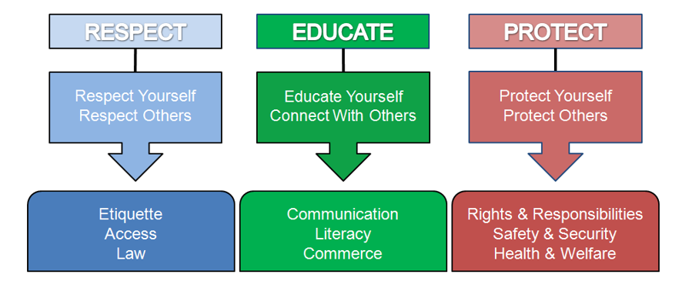
WHY DO WE NEED A CAP – Cyber Ambassador Platform ?
Cybercrime cases have risen during the Covid pandemic
We need Cyber Ambassadors (సైబర్ రాయబారి) - like you!
You will learn how to -
This Photo by Unknown Author is licensed under CC BY

Slide 9
LEARN-SHARE-REPEAT
In the Cyber Congress project,
Cyber Ambassadors will
learn and share their knowledge with their classmates,
neighbours and families
You will attend regular Council Meetings where
you will update your knowledge,
learn to solve new cyber issues and share your own experiences
Remember
You Are a Cyber Ambassador for life!

Slide 10
సైబర్ రాయబారి
OATH FOR BECOMING A CYBER AMASSADOR
Sailaja అనే నేను, తల్లితండ్రులకు తెలిసేలా వారి ఆమోదాన్ని, మరియు ప్రజా చట్టాలను గౌరవిస్తూ, ఇంటర్నెట్ నియమాలను ఎల్లప్పుడూ అనుసరిస్తాను అని, నా తల్లితండ్రులకు కానీ నా సంరక్షకులకు కానీ తెలియకుండా, నాకు ఆన్లైన్లో పరిచయమైన వారిని నేను కలవను అని, మరియ నేను నేర్చుకున్న నియమాలను నా స్నేహితులు మరియు కుటుంబ సభ్యులకు నేను గైడ్‌ చేస్తూ మద్దతు ఇస్తాను అని సైబర్ అంబాసిడర్ గా ప్రతిజ్ఞ చేస్తున్నాను

Slide 11

DIGITAL CITIZENSHIP:
Digital citizenship can be defined as the responsible behavior for the technological use or the norms one should follow online.
Empowering an active and ethical digital generation means equipping children to actively, positively and responsibly engage in society, whether this takes place on or offline.

Slide 12
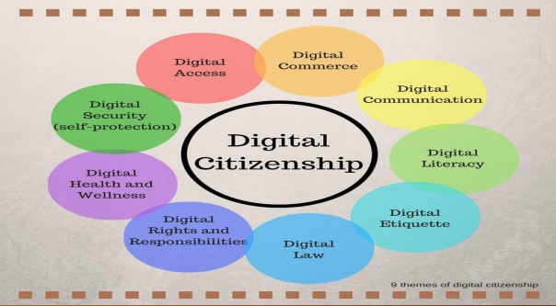
DIGITAL CITIZENSHIP
Digital citizenship involves:
competent and positive engagement with digital technology (access and skills)
active and responsible participation (empowerment and etiquette)
lifelong learning in formal, non-formal and informal contexts (including risk management and resilience).
As engaging with digital technologies comes with risks, children must be empowered with the tools and information needed to navigate digital environments in an ethical and responsible way. This includes knowing how to identify, anticipate and react effectively to risks, for example cyberbullying and threats to security and privacy.
One should be aware about the nine elements of the digital
citizenship:

Slide 13


Netiquettes-
Netiquette refers to acceptable behavior in digital environments. Fostering netiquette is an important policy goal and an essential component of digital literacy and citizenship. Examples of some positive and negative behaviors in which children may engage in digital environments include:
Mischief accounts | Trolling
These accounts on social platforms collectively managed by youth; they can act as fora to discuss complex social and political topics, and to intervene in cases of bullying, for example. However, they can also have a negative use e.g., to spread misinformation or share “cringeworthy” content. | Causing disruption or triggering conflict in digital environments for one’s own amusement. Internet trolls, often under the guise of anonymity, write controversial comments to get a rise out of other users.
Notes:
acceptable way of using the internet.

Slide 14


Notes:
Be careful while downloading Apps – Check age limit – don’t download those

Slide 15
Notes:
She is being harrsed on the Instagram- lost confidence and cannot focus on health, studies so on….

Slide 16

Notes:
Don't trust strangers on platform – Reality can be different

Slide 17
Notes:
Cannot get into any job as his past ~ online tone is a blocker (daunting him)

Slide 18



Notes:
Money is also in digital form- be careful don’t share your passwords

Slide 19



Notes:
So many big and small companies are getting hacked every day

Slide 20

CREATION OF GROUPS ON VARIOUS PLATFORMS
GMAIL :
Visit Google Contacts: You can find Google Contacts in the middle of the bottom row of your Google Apps tab.
Click “Contacts”, “Frequently contacted”, or “Directory”:
It’s likely you won’t have contacts saved in Google Contacts, but you can still access the email addresses of people you frequently interact with by clicking “Frequently contacted” or everyone who currently works at your company by clicking “Directory" in the left side bar.
Select the contacts you want to include in your group.
Choose the “Label” icon and press “Create Label”.
Name your label and type your group’s name in the recipients box to send an email to your group.

Slide 21

C. CREATION OF GROUPS ON VARIOUS PLATFORMS:
WHATSAPP: ANDROID :
1. Open the application and tap on the chat’s tab.
2. Tap on the three dots that appear on the top right corner. Doing so will prompt a menu.
3. Tap on the new group option which will prompt you to select members for your new group.
4. Tap on the contact’s name to add them to group.
5. You cannot add people who aren't currently in your contacts.
6. Tap the "OK" button in the top right corner of your screen when you're ready to continue
7. You can also add a group name according to your choice. The field is available at the top of the screen.
8. You can add a display picture for your group. You can do this by tapping the empty box next to the group name, then selecting a photo from your photo library.

Slide 22
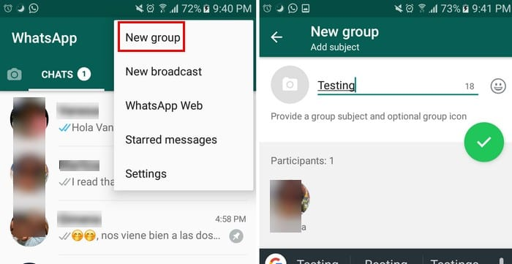
C. CREATION OF GROUPS ON VARIOUS PLATFORMS:

Slide 23

C. CREATION OF GROUPS ON VARIOUS PLATFORMS:
WHATSAPP: IPHONE
1. Open the application and tap on the chat’s tab.This is in the toolbar at the bottom of the screen.
2. Tap on the new group option. This should be in the top right corner of the Chats menu.
3. You will need to have at least one chat in your Chats menu before you can create a group; if you've only just installed WhatsApp, simply send a one-word chat to a contact in order to activate the "New Group" option.
4. Tap on the contact’s name to add them to the group. You can do this with up to 256 people; the name and icon of each person you add will show up at the top of your screen as you add contacts.
5. Tap "Next" in the top right corner of your screen. This will take you to the "New Group" creation page.
6. Add a "Group Subject" to name the group (25 character maximum).
7. Add a photo by tapping the camera icon on the left of the Group Subject field.
8. Delete participants from the group before you officially form it.Tap on create and you have officially created a WhatsApp group.

Slide 24
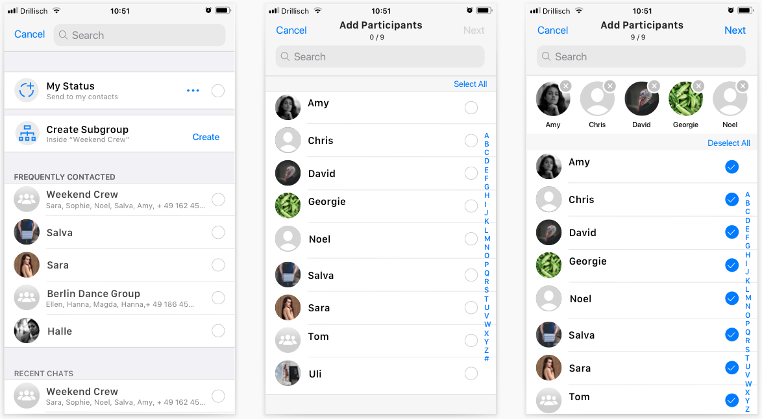
C. CREATION OF GROUPS ON VARIOUS PLATFORMS:

Slide 25

D. HOW TO USE: 1) GOOGLE DOCS Step 1: Download the Google Docs app On your Android phone or tablet, open the Google Play app Google Play.

Slide 26
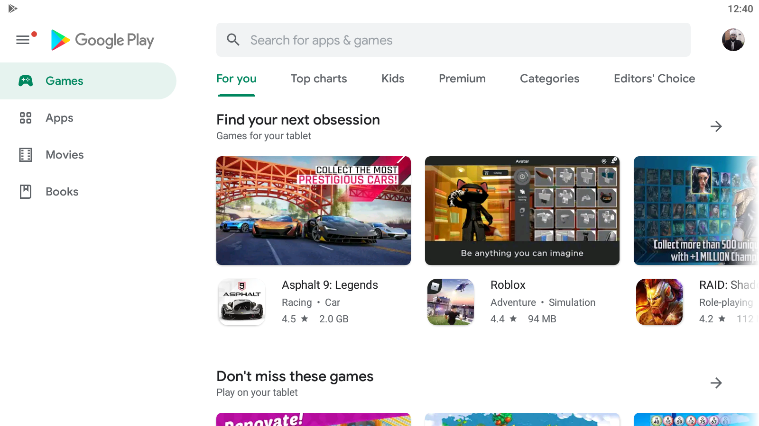
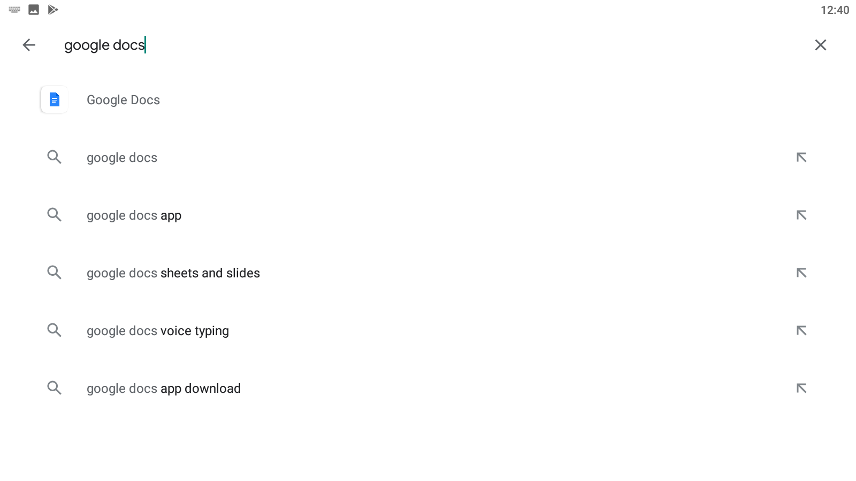
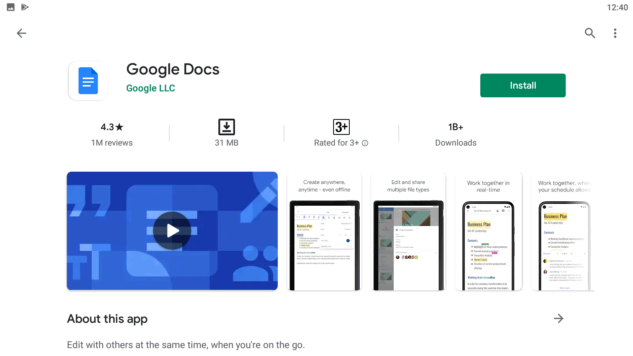

Slide 27
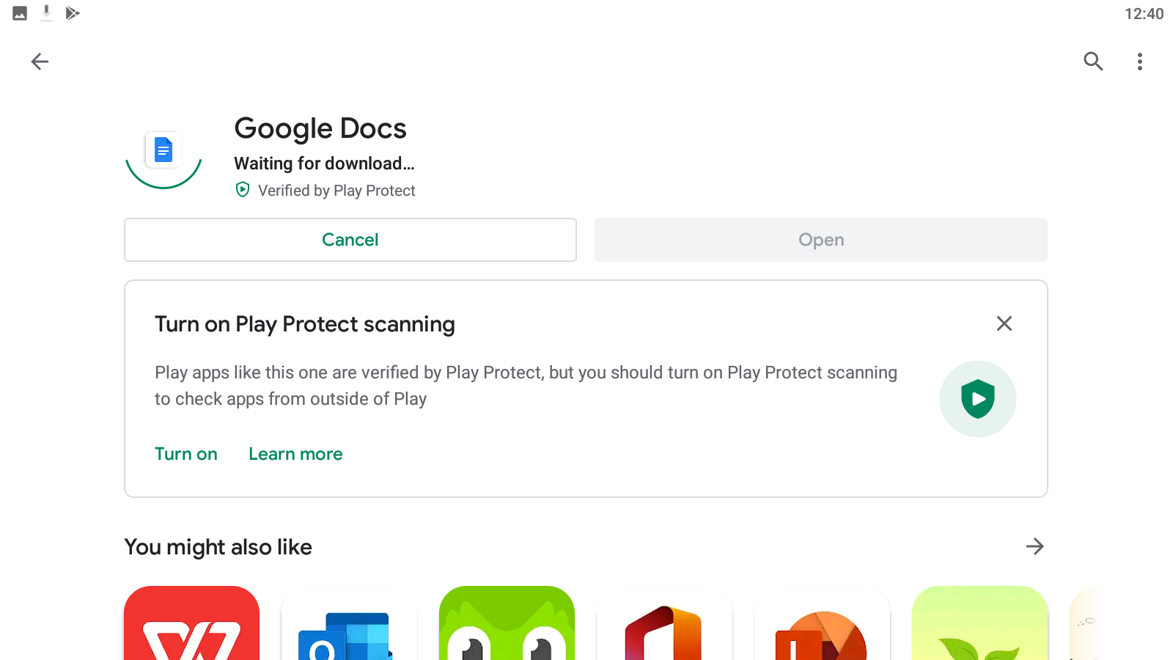
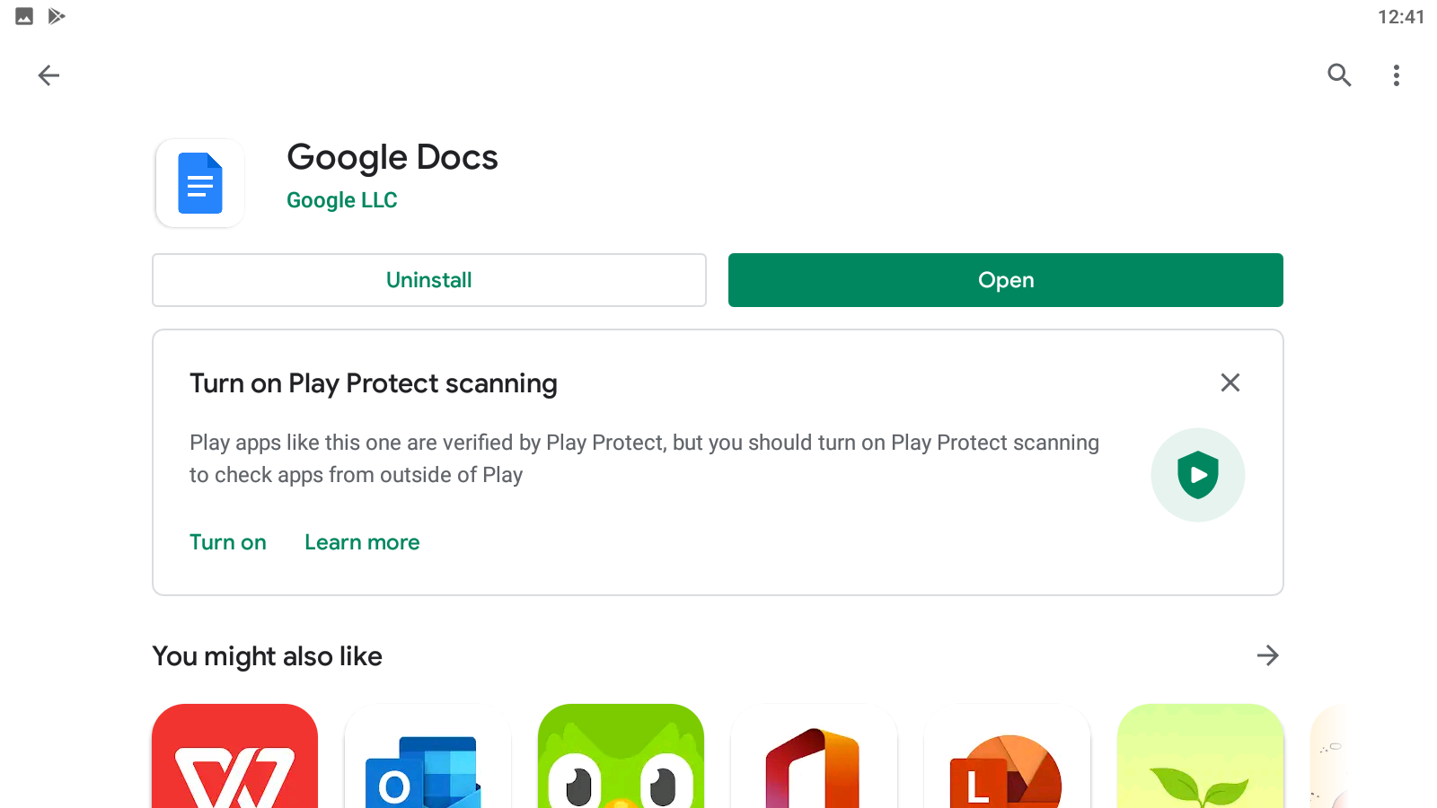

Slide 28
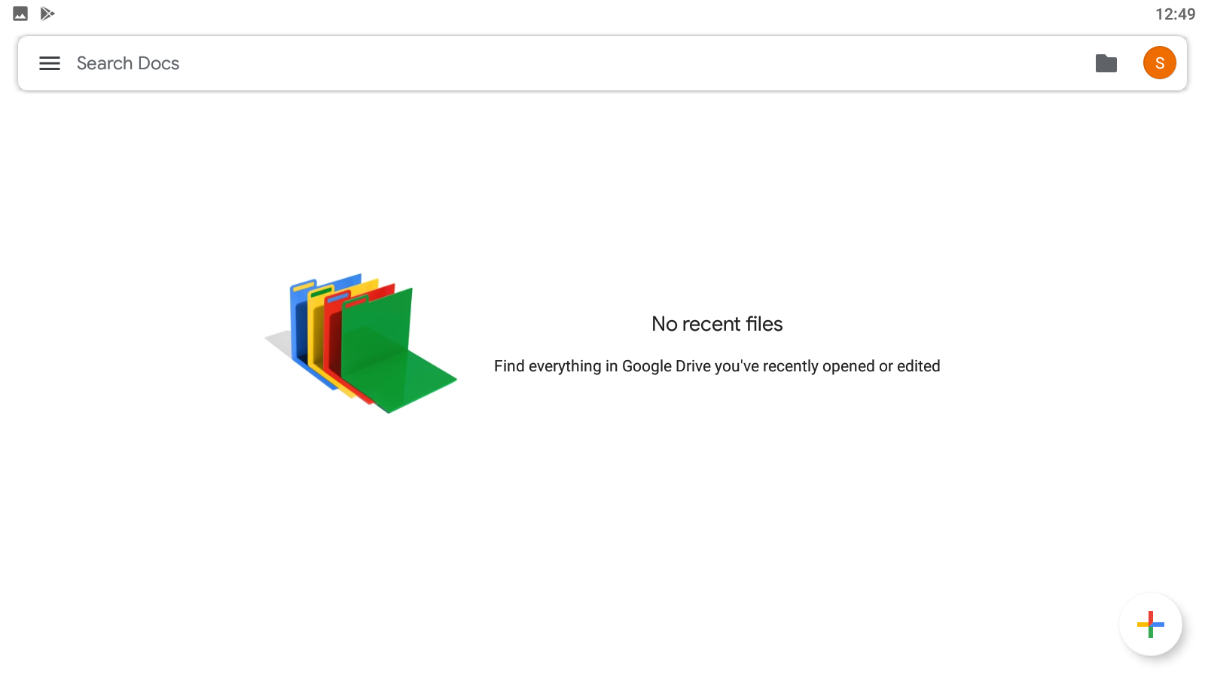

Slide 29
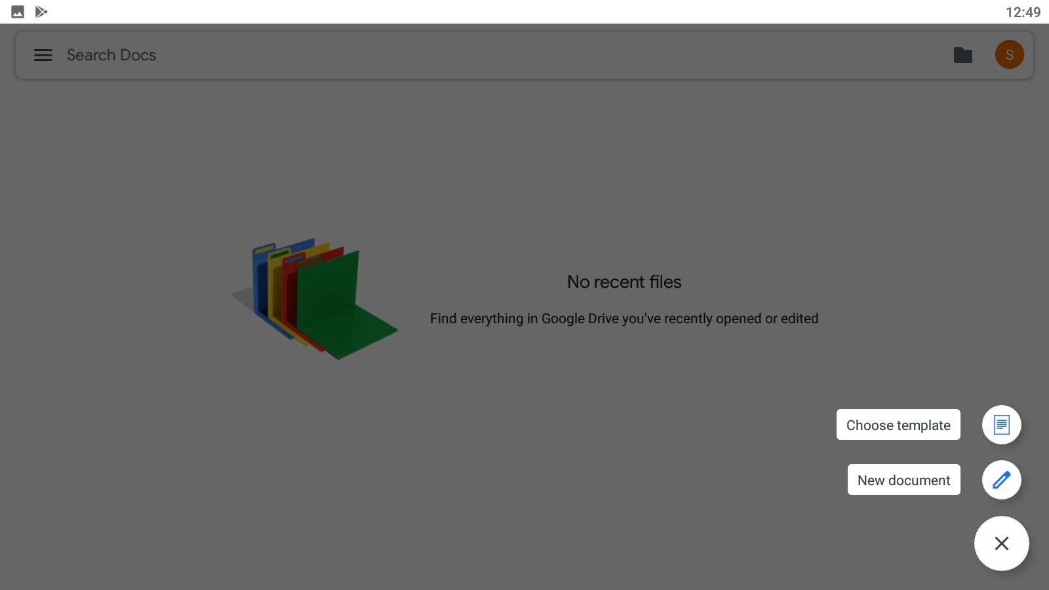

Slide 30


Slide 31
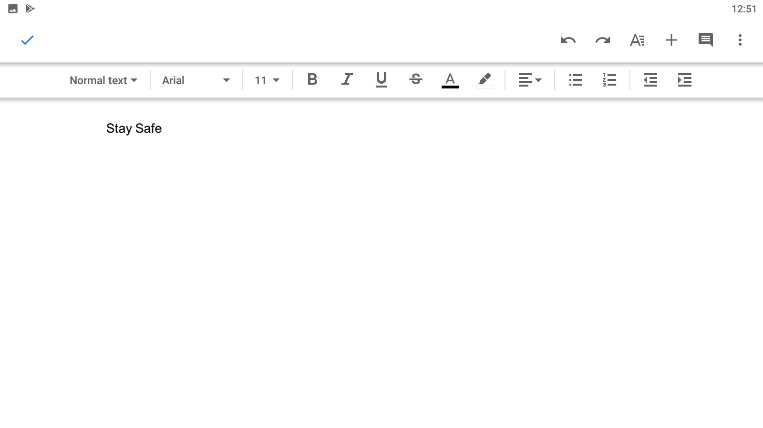
Click on Tick icon to save

Slide 32
Click on 3 dots

Slide 33
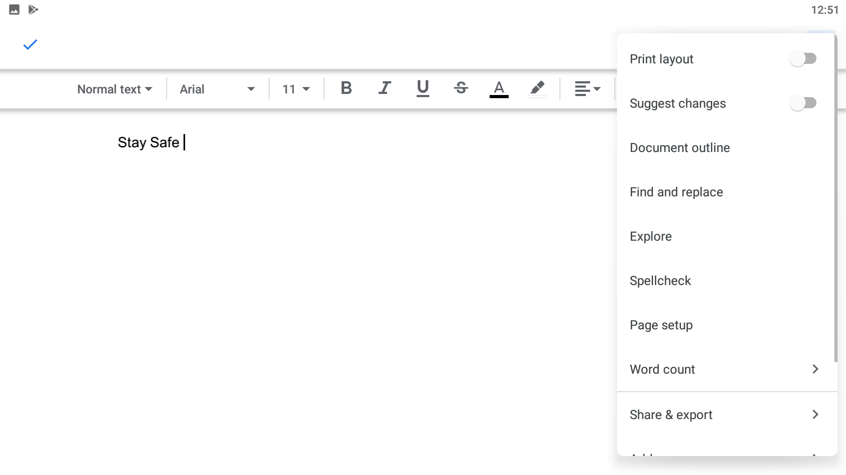

Slide 34
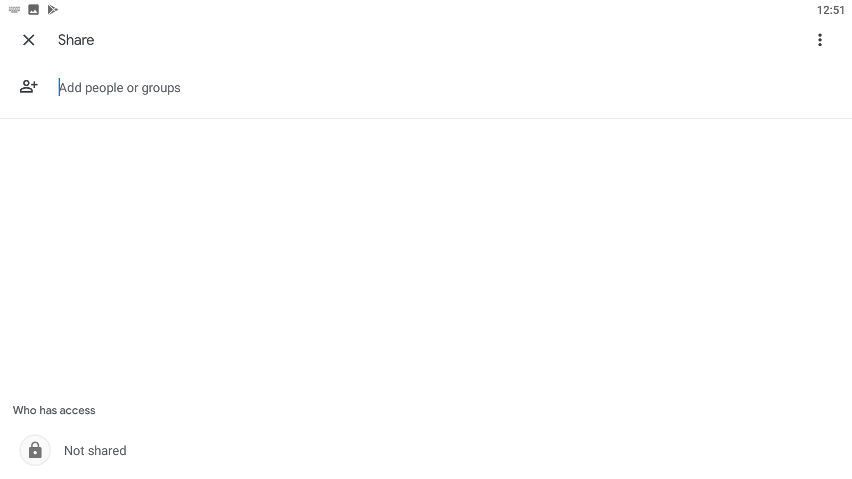
Enter Email Here

Slide 35
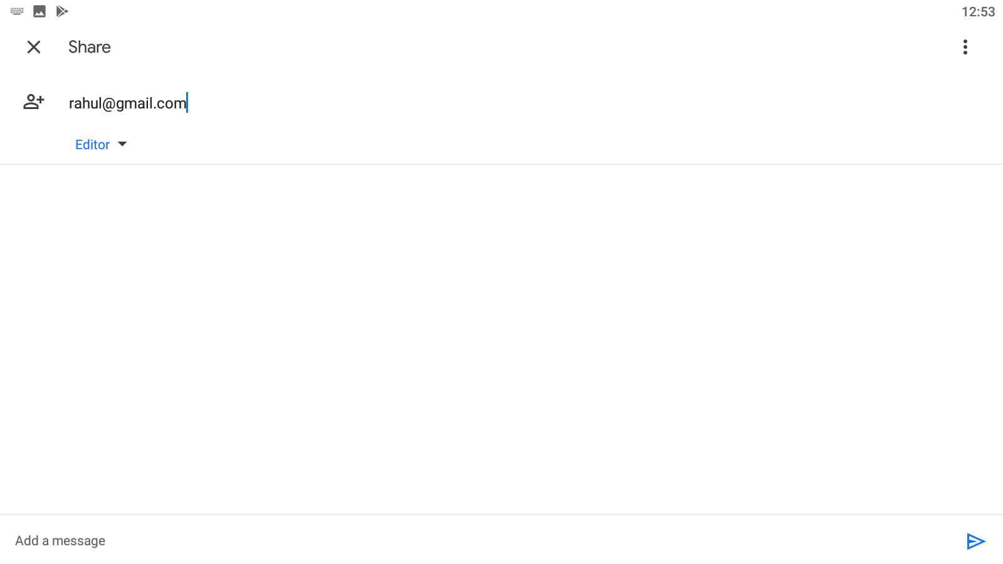
Click on Tick icon to save

Slide 36
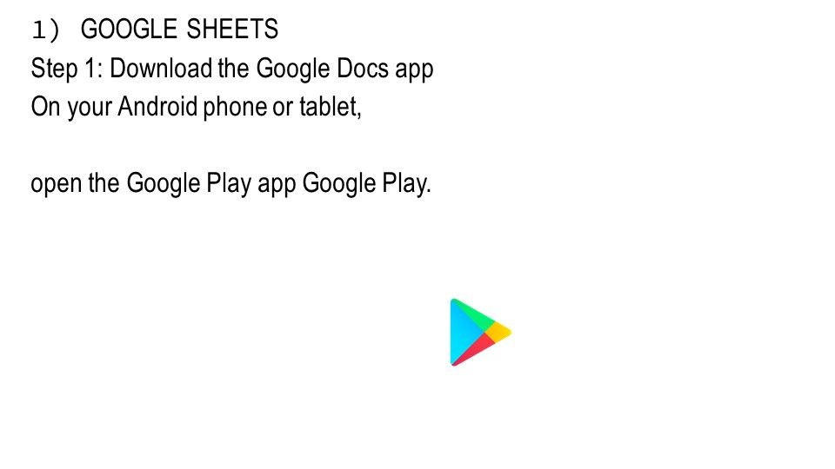

Slide 37


Slide 38
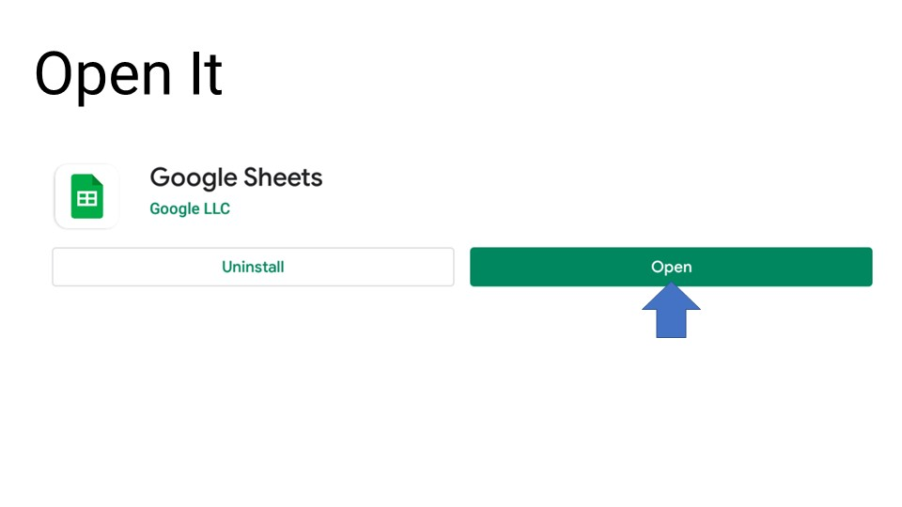

Slide 39
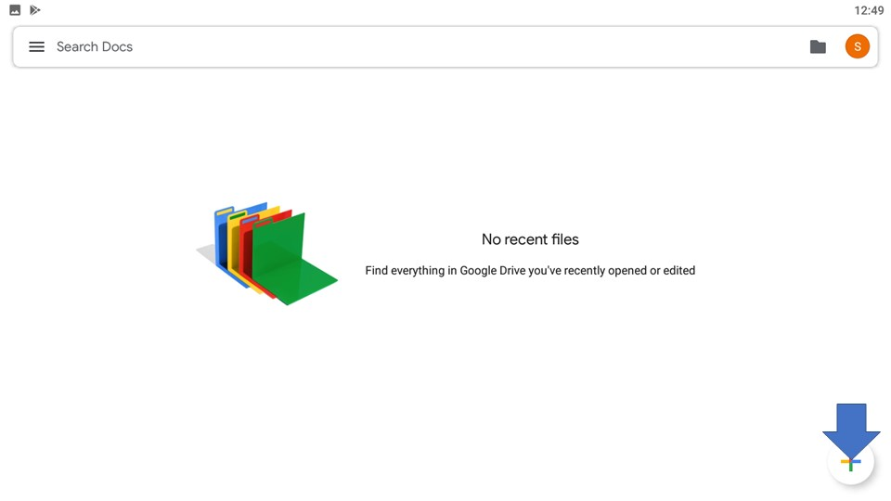

Slide 41


Slide 42
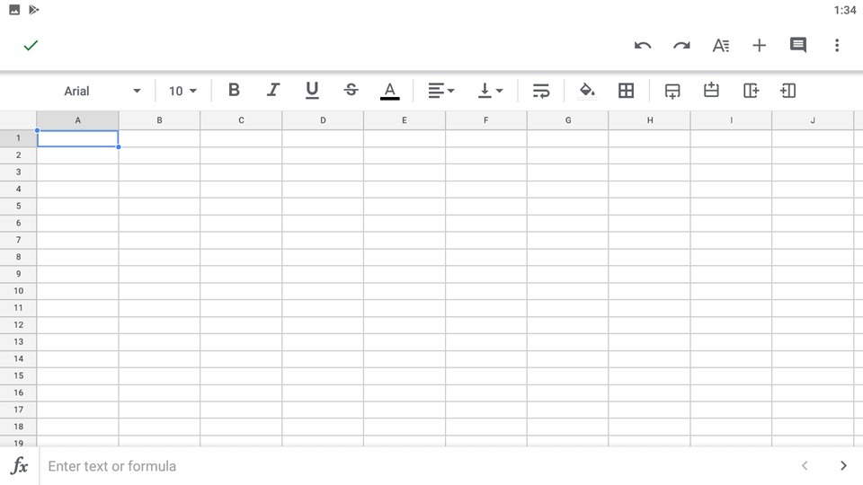

Slide 43
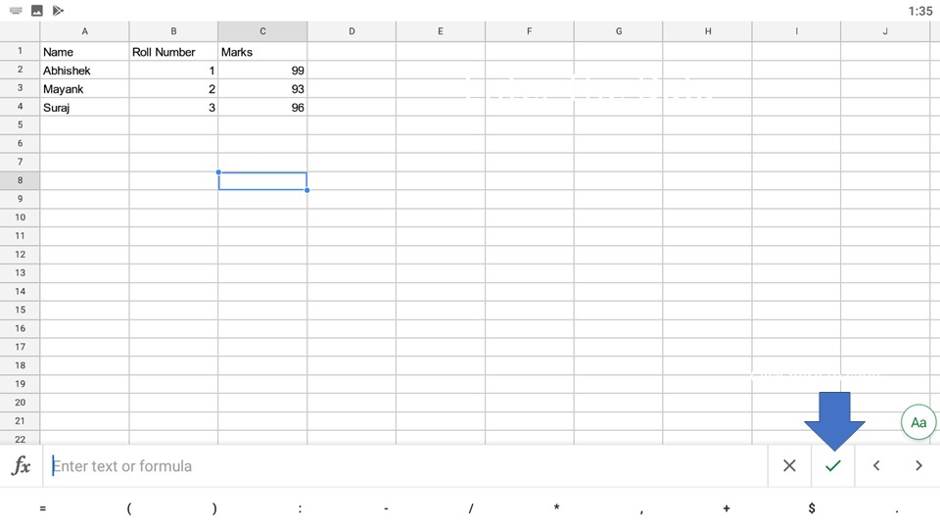

Slide 44
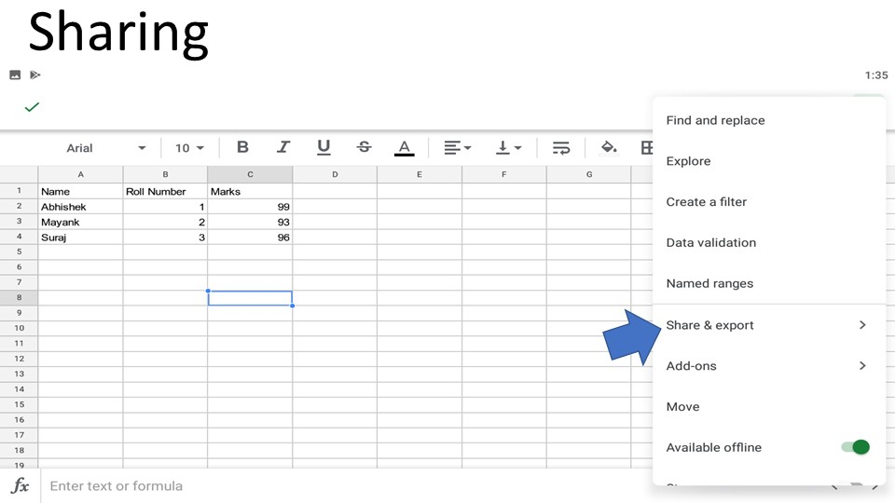

Slide 45
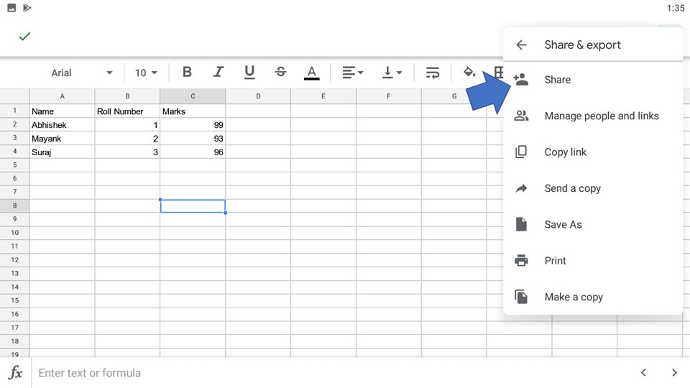

Slide 46
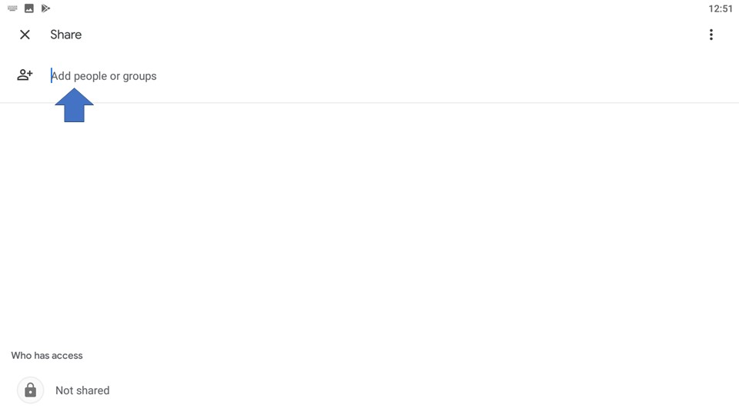

Slide 47
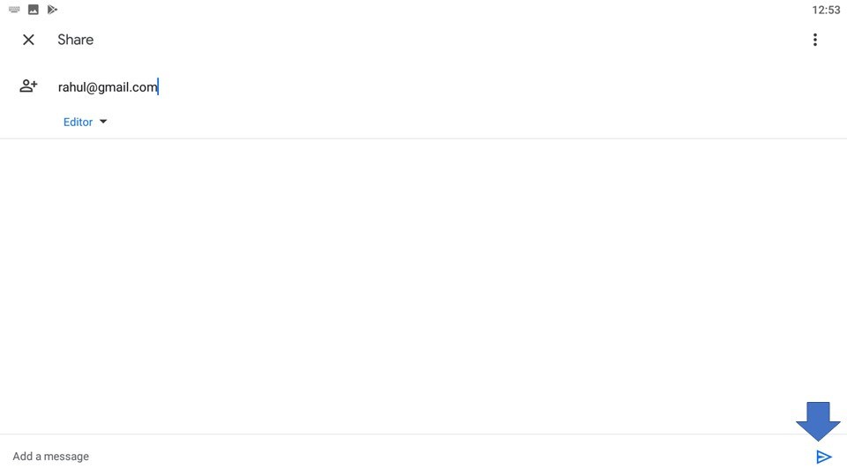

Slide 48
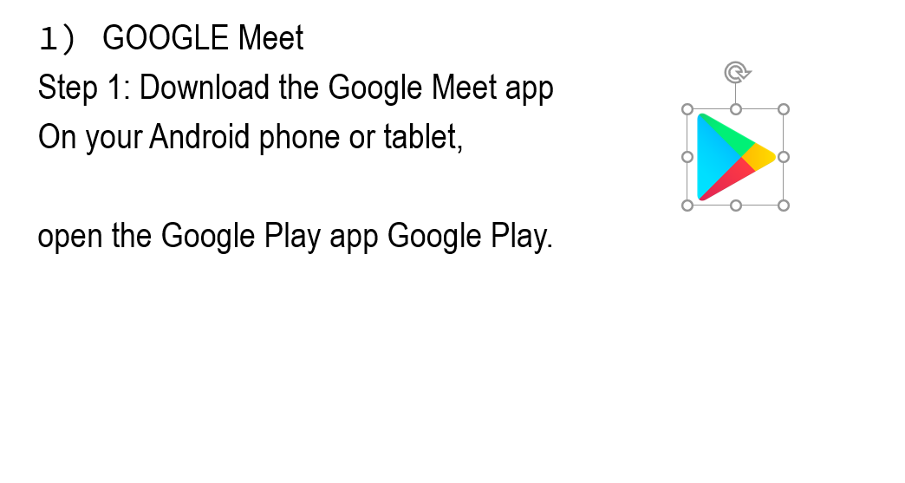

Slide 49
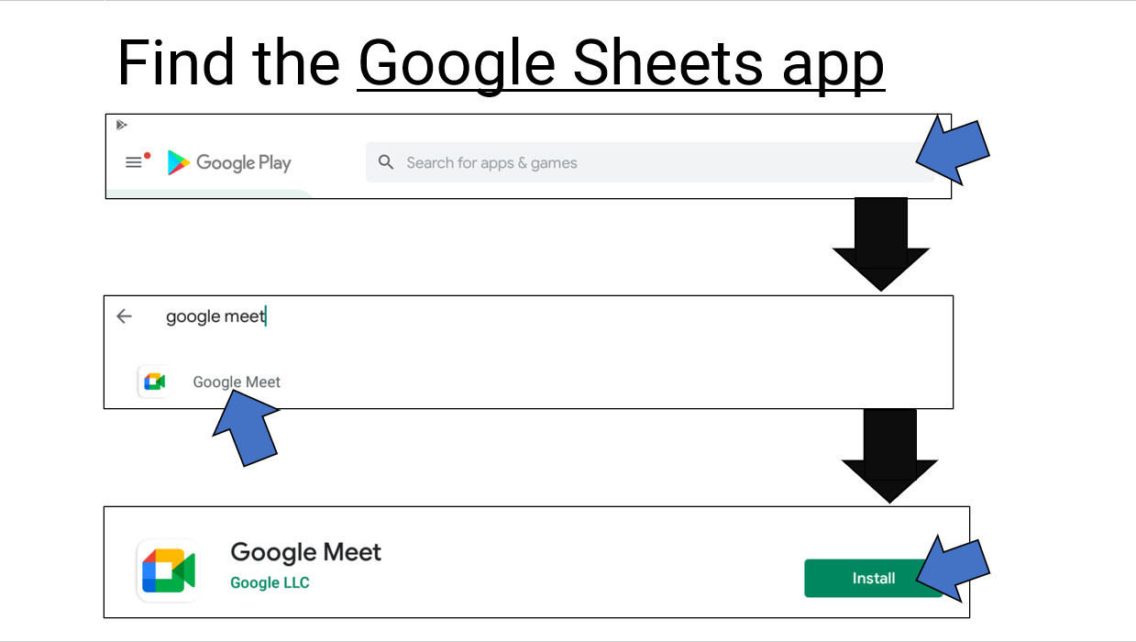

Slide 50
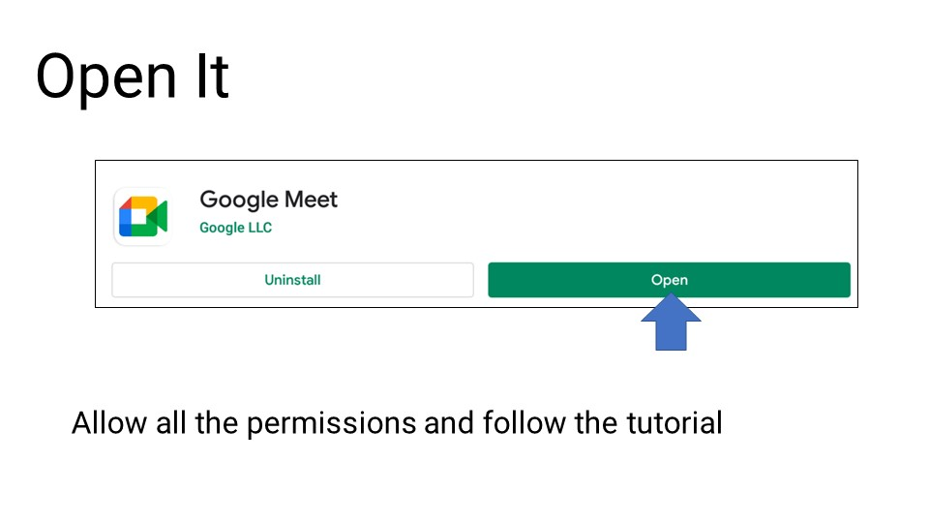

Slide 51
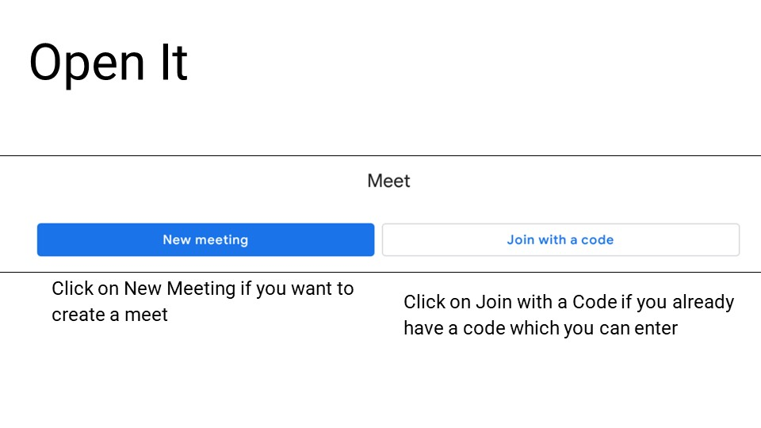

Slide 52
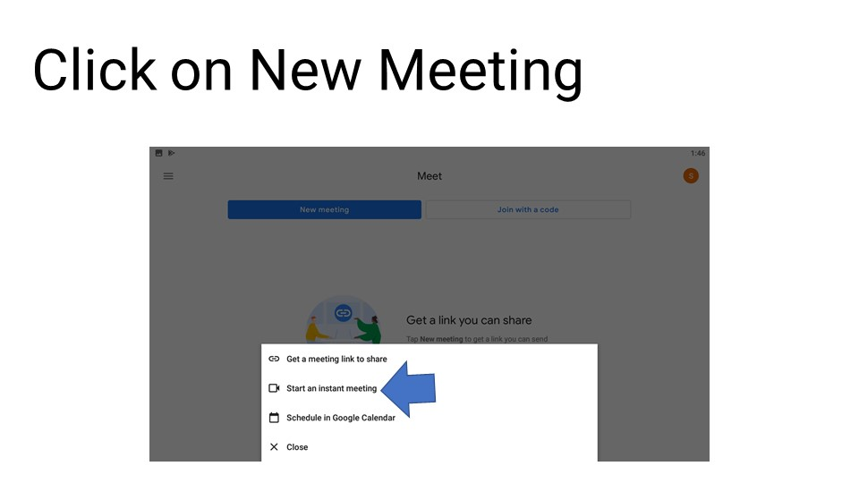

Slide 53
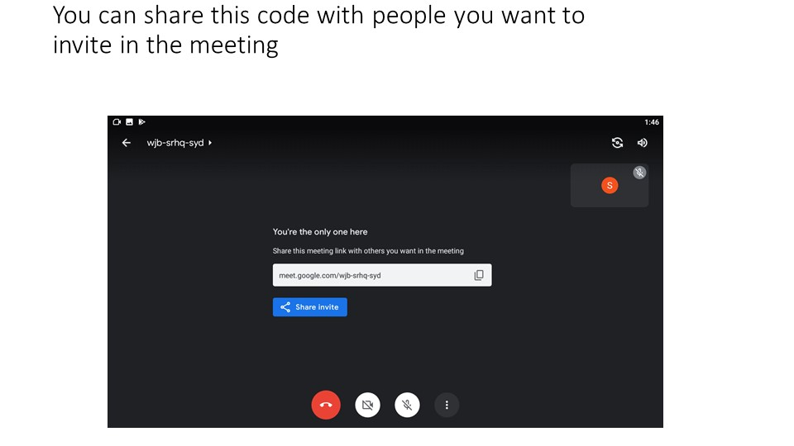

Slide 54
A. SAFE BROWSING
vi. EXTENSIONS/ADD-ONS:
1. What are they?
a. Extensions - Small helper tools to give you more features in Chrome
b. Add-ons - Extra tools for Docs, Sheets, Forms, and Slides.
2. How can we install/use them?
a. Extensions - Installed from the Chrome Web Store at chrome.google.com/webstore
b. Add-ons - Installed from the Add-ons menu in Docs, Sheets, Forms, and Slides.
3. Which devices support them?
a. Extensions - PCs, Macs, and Chromebooks running the Chrome web browser
b. Add-ons - PCs, Macs, and Chromebooks running any major browser

Slide 55
A. SAFE BROWSING
4. How do you run/execute them?
a. Extensions - Click the icon for the extension in the top right corner of the Chrome browser. Can typically run on any webpage in Chrome.
b. Add-ons - Click the add-on in the Add-ons menu in Docs, Sheets, Forms, and Slides. Only run inside of Docs, Sheets, Forms, and Slides.
5. How can you disable/remove them.?
a. Extensions - Can be temporarily disabled. Right click on the extension icon, choose “Manage extensions” and uncheck “Enabled”. Right click on the extension icon and choose “Remove from Chrome”.
b. Add-ons - Can not be temporarily disabled. Only can be removed. Click “Add-ons” then “Manage Add-ons” then “Manage” then “Remove”

Slide 56
A. SAFE BROWSING
6. Threats and Securities:
a. Chrome extensions can perform a variety of tasks, from showing the Alexa ranking of websites to blocking ads to processing cryptocurrency payments on-site, and much more.
b. Some extensions might request access to a microphone or webcam, and others might require permission to modify web page content.
c. Chrome has a Web Store where developers can publish extensions and users can install them on their browsers.
d. Despite the best efforts of Google to stop hackers or notorious people from doing misharm to individuals, we all need to be aware of the security issues they possess.
e. Malicious actors disguise their malware under the guise of extensions that perform useful tasks. Once the user installs the extension, hackers can perform various harmful tasks without the user’s knowledge.
f. What makes malicious extensions especially dangerous is that once installed, users allow them the freedom to do anything they want, including sending the user’s data to clandestine servers without being flagged as malicious activity.

Slide 57
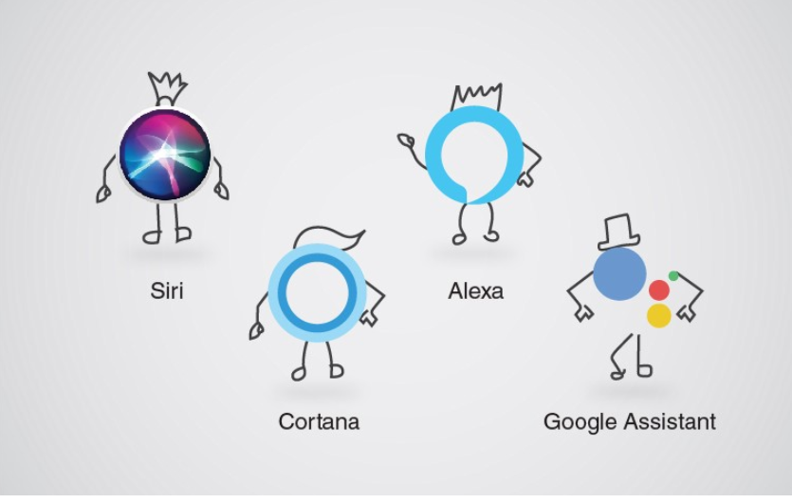
Digital Assistants
Apple apologizes for allowing workers to listen to Siri recordings
Google has paused the program in Europe after a leak of recordings, and pledged to review its safeguards
Microsoft did not change it program, listening to its Cortana voice assistant but also to Skype conversations it updated its privacy policy
Amazon Echo’s privacy issues go way beyond voice recordings

Slide 58

You are our Cyber Ambassadors

